Slide 1
Version Control system
Concept without version control System

Slide 3
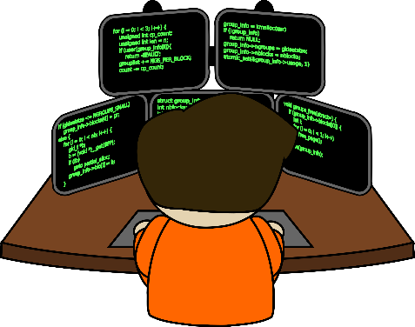

Coder 1st
Distribute 3 Tasks
Task 1
Task 2
Task 3

Slide 4
Leader
Main Task
Coder 2
Coder 3
Coder 4
Distribute 3 Tasks
Task 1
Task 2
Task 3

Slide 5
Leader
After completion of Task 1
Main Task
Coder 2
Coder 3
Coder 4
Task 2 Depended on Task 1
Task 1
Task 2
Task 3

Slide 6
Leader
After completion of Task 1
Main Task
Coder 2
Coder 3
Coder 4
Coder 2 submit code to Leader
Task 1
Task 2
Task 3

Slide 7
Leader
Larder Give changes to Coder 2 and code to Coder 3 & Coder 4
Main Task
Changes
Coder 2
Coder 3
Coder 4
Task 2
Task 3

Slide 8
Leader
Main Task
Coder 2
Coder 3
Coder 4
Changes
Task 2
Task 3

Slide 9
Leader
Main Task
Coder 2
Coder 3
Coder 4
Changes
Task 2
Task 3

